Slide 1
Dictionary
A Dictionary represents a group of elements in the form of key value pairs.
Dictionary in Python is an unordered collection.
Dictionaries are mutable so we can modify it’s item, without changing their identity.
Dictionaries are represented using curly bracket { }.
Ex:-
stu = {101: ‘Rahul’, 102: ‘Raj’, 103: ‘Sonam’ }
fees= {‘rahul’:2000, ‘raj’:3000, ‘sonam’:8000}

Slide 2
Creating an Empty Dictionary
Syntax:- dict_name = { }
Ex:- fees = { }

Slide 3
Creating a Dictionary
A dictionary is created in the form of key-value pair where keys can’t be repeated and must be immutable and values can be of any datatype and can be duplicated.
keys are case sensitive.
Syntax:- dict_name = {key1:value1, key2:value2,…}
Ex:-
stu = {101: ‘Rahul’, 102: ‘Raj’, 103: ‘Sonam’ }
fees = {‘rahul’:2000, ‘raj’:3000, ‘sonam’:8000 }
fees = {
‘rahul’: 2000,
‘raj’: 3000,
‘sonam’: 8000
}

Slide 4
Key Rules
While writing key we must follow the following rules:
Key should be unique.
If we mention same key again, the old key will be overwritten.
Key should be immutable type ex:- integer, string or tuple.
We can not use list or dictionary as key.

Slide 5
Accessing Dictionary
We can access the value of a dictionary by referring to its key name, inside square brackets.
stu = {101: ‘Rahul’, 102: ‘Raj’, 103: ‘Sonam’ }
fees = {‘rahul’:2000, ‘raj’:3000, ‘sonam’:8000}
print(stu[101])
print(stu[102])
print(stu[103])
print(fees[‘rahul’])
print(fees[‘raj’])
print(fees[‘sonam’])
[101] | Rahul
[102] | Raj
[103] | Sonam
stu
[‘rahul’] | 2000
[‘raj’] | 3000
[‘sonam’] | 8000
fees

Slide 6
Modifying
We can modify the existing value of key by assigning a new value.
stu = {101: ‘Rahul’, 102: ‘Raj’, 103: ‘Sonam’ }
stu[102] = ‘Python’

Slide 7
Inserting/Adding new item
We can add an item to dictionary just by mentioning a new key-value pair into an existing dictionary.
If we mention a key which is already exists in the dictionary then the value gets updated/modified rather then adding a new item.
The new item my be added at any place in the dictionary as dictionary is an unordered collection.
stu = {101: ‘Rahul’, 102: ‘Raj’, 103: ‘Sonam’ }
stu[104] = ‘sipalaya’

Slide 8
Deletion
We can delete an item of dictionary or entire dictionary using del statement.
stu = {101: ‘Rahul’, 102: ‘Raj’, 103: ‘Sonam’ }
Deleting an item
del stu[102]
Deleting entire Dictionary
del stu

Slide 9
Testing Key
We can check whether a key is already exists in the dictionary or not, for this purpose we use membership operator.
stu = {101: ‘Rahul’, 102: ‘Raj’, 103: ‘Sonam’ }
101 in stu # If exists returns True
104 not in stu # If not exists returns True

Slide 10
Clear ( ) Method
This method is used to remove all the elements from the dictionary.
Syntax:- dict.clear( )
Ex:- stu.clear( )

Slide 11
copy ( ) Method
This method is used to copy all the elements from the existing dictionary into a new dictionary.
Syntax:- dict.copy( )
Ex:-
new_stu = stu.copy( )

Slide 12
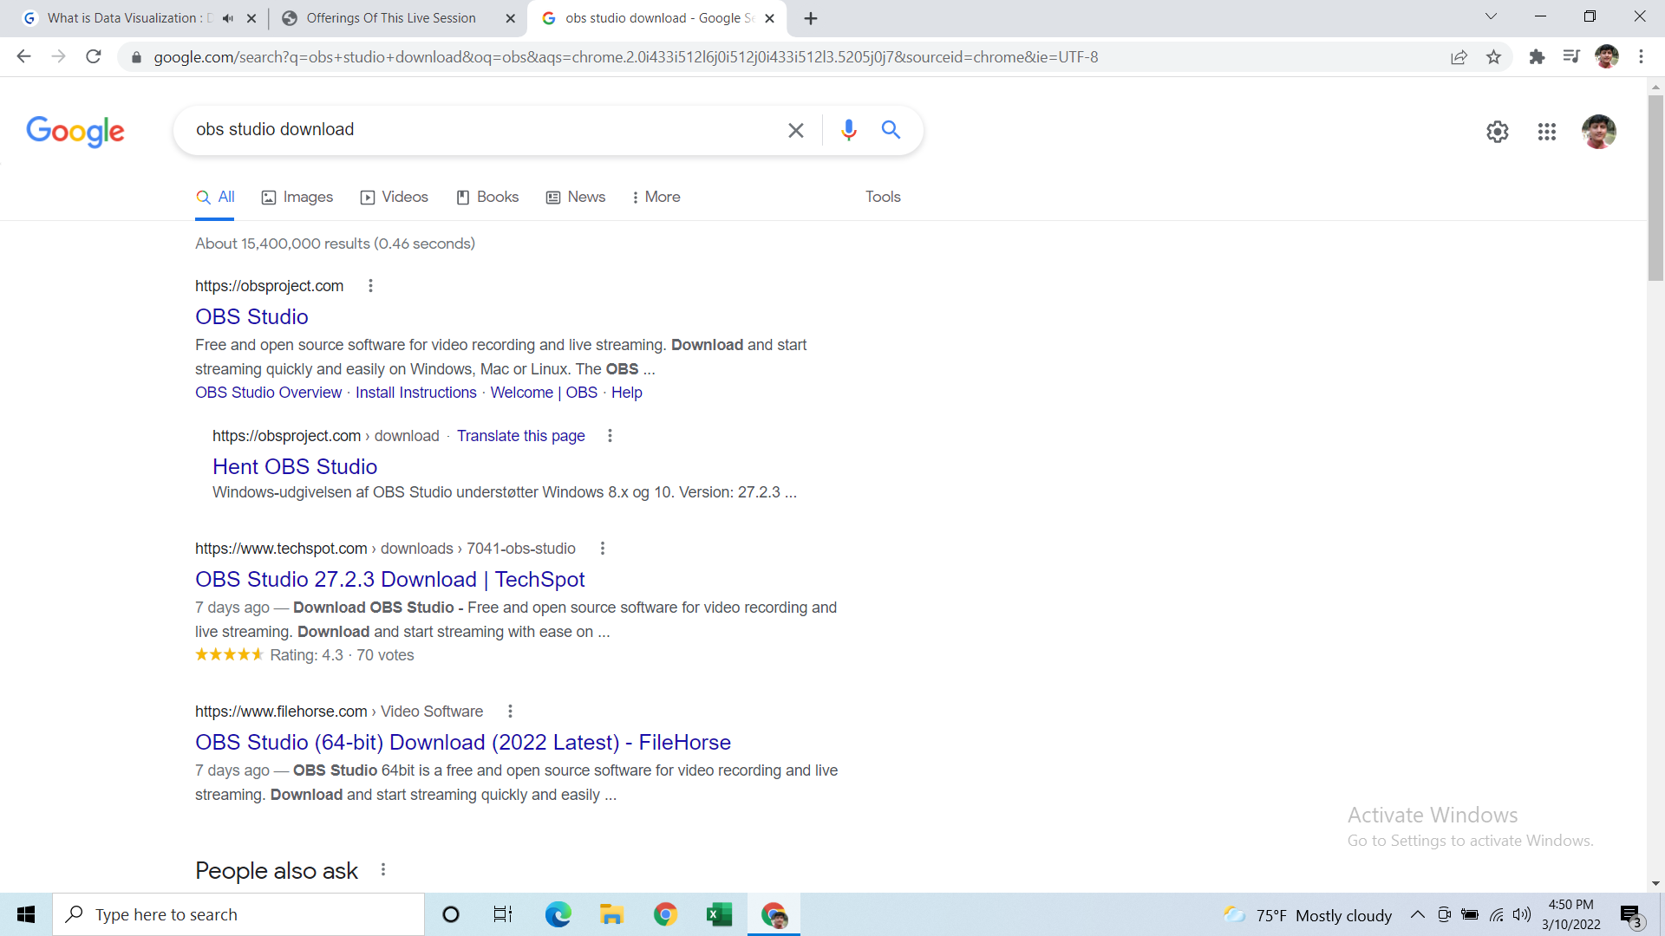
fromkeys ( ) Method
This method is used to create a new dictionary with the specified keys and values.
Syntax:- dict.fromkeys(keys, value)
Ex:-
key = (101, 102, 103)
value = ‘sipalaya’
new_stu = dict.fromkeys(key, value)

Slide 13
get ( ) Method
This method returns the value of the specified key.
If key is not found then it will return none or default value.
Syntax:- dict_name.get(key, defaultvalue)
Ex:-
stu.get(104)
stu.get(104, ‘sipalaya’)

Slide 14
items ( ) Method
This method returns an object that contains key-value pairs of dictionary.
The pairs are stored as tuples in the object.
Syntax:- dict_name.items()
Ex:-
stu.items()

Slide 15
keys ( ) Method
This method returns a sequence of keys from the dictionary .
Syntax:- dict_name.keys()
Ex:- stu.keys()

Slide 16
values ( ) Method
This method returns a sequence of values from the dictionary .
Syntax:- dict_name.values()
Ex:- stu.values()

Slide 17
update ( ) Method
This method is used to update the dictionary with the specified key value pair.
Syntax:- dict_name.update(iterable)
Ex:- stu.update({105: ‘Gupchup’})

Slide 18
pop ( ) Method
This method is used to remove the item with specified key.
It returns the removed item’s value.
If key is not found then the a default value is returned.
If key is not found and default value is not given then shows KeyError.
Syntax:- dict_name.pop(key, defaultvalue)
Ex:- stu.pop(101)
Ex:- stu.pop(110, ‘sipalaya’)

Slide 19
popitem ( ) Method
This method is used to remove the item which was last inserted into the dictionary.
It returns the removed item in the form of tuple, Pairs are returned in LIFO order.
Syntax:- dict_name.popitem( )
Ex:- stu.popitem()

Slide 20
setdefault ( ) Method
This method returns the value of the specified key.
If key is not found then it inserts key with the specified value.
Syntax:- dict_name.setdefault(key, value)
Ex:- stu.setdefault(109, ‘Rohit’)

